Slide 1


Introduction to Ions
We will understand why ions are formed and how they get their charge
Notes:
Insert cover image and use transparency settings to fade image.

Slide 2
We will understand why ions are formed and how they get their charge
TRACK WITH ME
READ WITH ME
Define the terms ion, cation, and anion
Explain how and why ions form, in terms of electron configurations

Slide 3

We will understand why ions are formed and how they get their charge
Ions are essential for life.
If there were no ions, your body would not function! The cells in your body use ions to communicate.
Ions are also what make up crystals in the Earth’s crust, and lightning in the atmosphere.
CHECK FOR UNDERSTANDING
Name 1 ion in your body

Slide 4
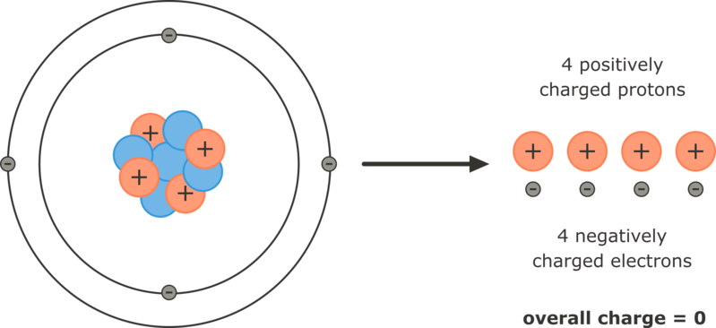
We will understand why ions are formed and how they get their charge
Atoms are electrically neutral because they have equal number of positive protons and negative electrons
The positive and negative charges cancel out, so the atom has no overall charge.

Slide 5
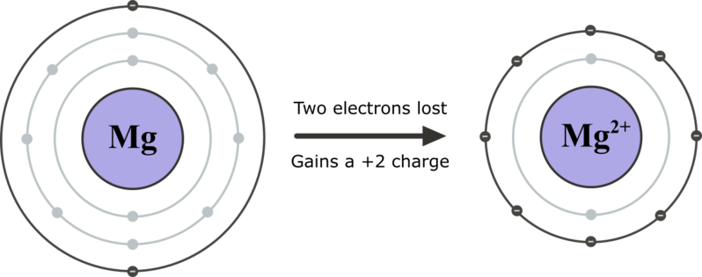
We will understand why ions are formed and how they get their charge
Ions are charged particles that form when an atom or molecule loses or gains electrons.
Atoms are most stable when their valence (outer) electron shell is full of electrons. Atoms without full valence shells can gain or lose electrons to become stable, and in the process, they become ions.

Slide 6
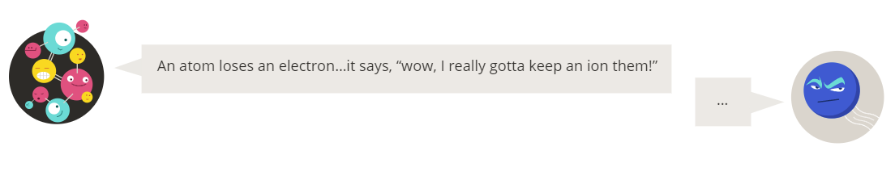
We will understand why ions are formed and how they get their charge

Slide 7

We will understand why ions are formed and how they get their charge
Electrons are negatively charged.
If an atom gains electrons, it becomes a negatively charged ion.
If an atom loses electrons, it becomes a positively charged ion.

Slide 8
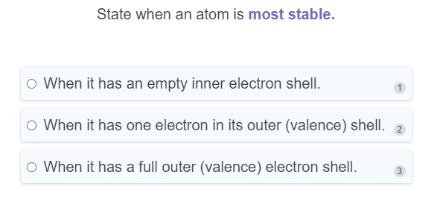
On your whiteboards.

Slide 9
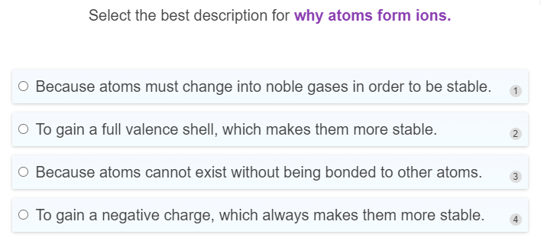
On your whiteboards.

Slide 10
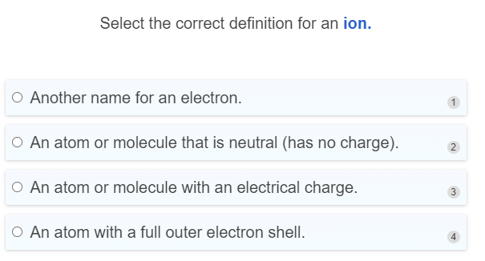
On your whiteboards.

Slide 11
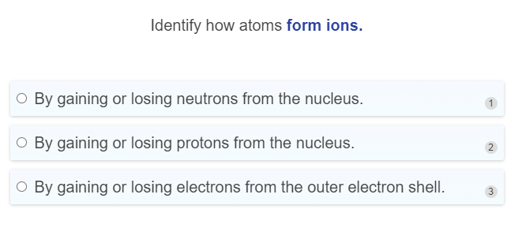
On your whiteboards.

Slide 12
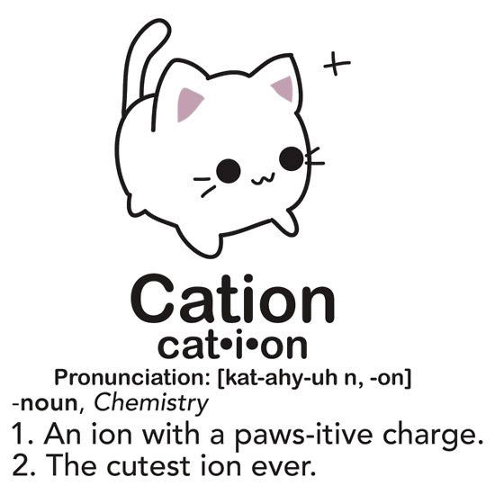
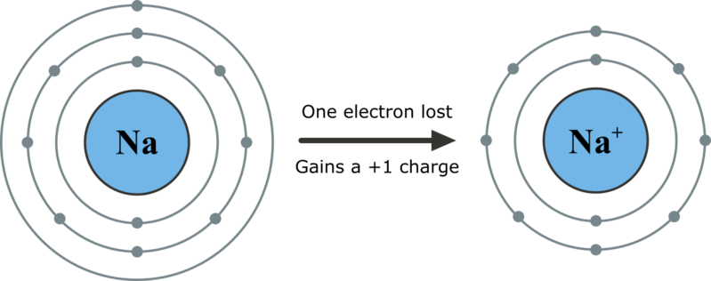
We will understand why ions are formed and how they get their charge
Cations (Positive Ions)
Atoms that have very few electrons in their outer shell, will lose electrons to have a full shell.
The ion that is formed will have a positive charge equal to the number of electrons lost.

Slide 13
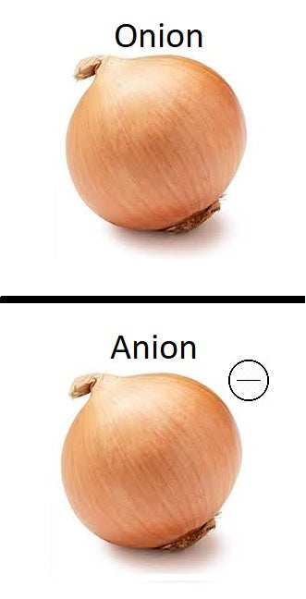
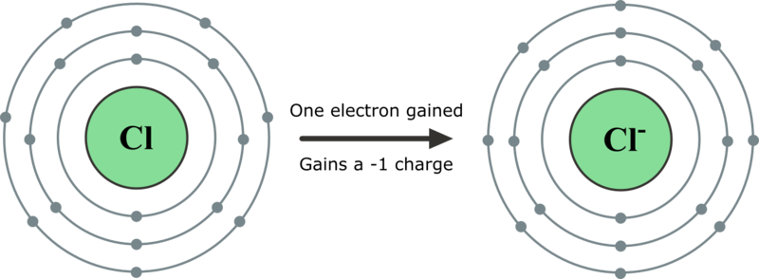
We will understand why ions are formed and how they get their charge
Anions (Negative Ions)
Atoms that have many electrons in their outer shell, will gain electrons to have a full shell.
The ion that is formed will have a negative charge equal to the number of electrons gained.

Slide 14
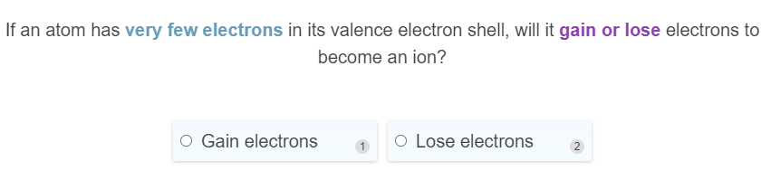
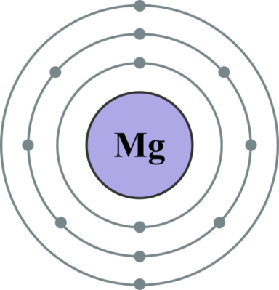
On your whiteboards.

Slide 15
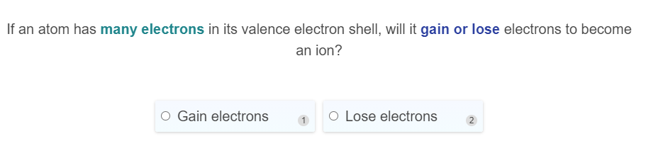
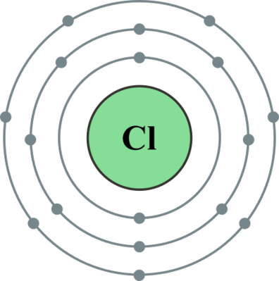
On your whiteboards.

Slide 16
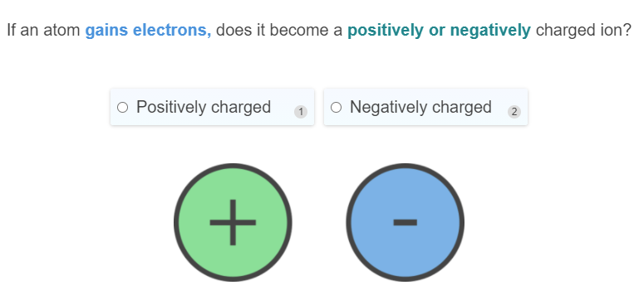
On your whiteboards.

Slide 17
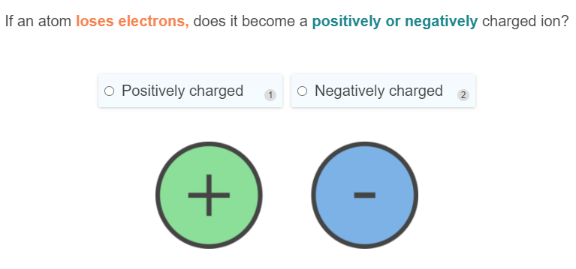
On your whiteboards.

Slide 18
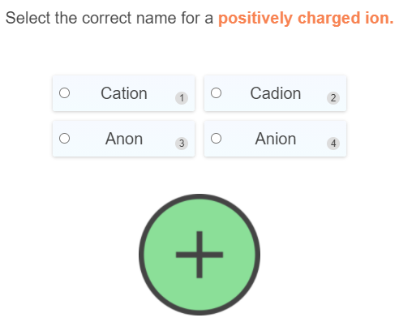
On your whiteboards.

Slide 19
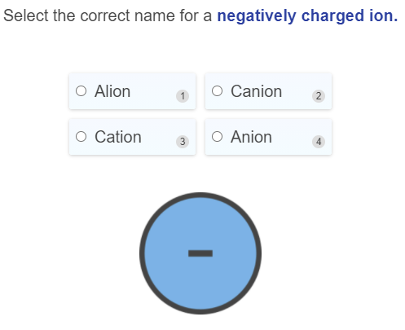
On your whiteboards.

Slide 20
We will understand why ions are formed and how they get their charge
Steps to identifying the ionic charge:
Step 1- Draw the electron configuration
Step 2 - Work out how many electrons would be lost or gained to make a full shell
Step 3 - If you add electrons (negative charge) If you remove electrons (positive charge)

Slide 21
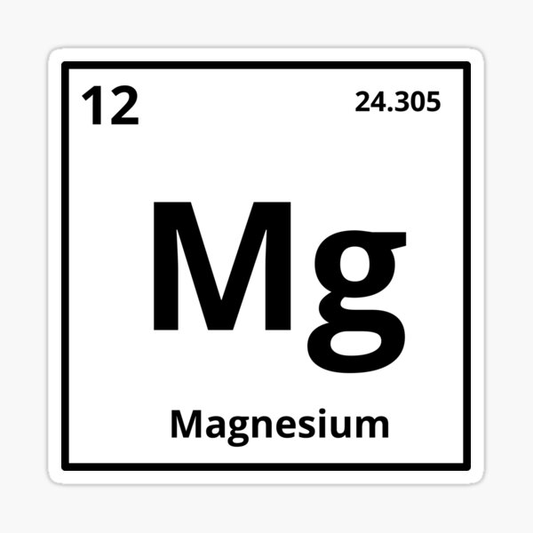
We will understand why ions are formed and how they get their charge
What would the charge be of the following?
Step 1: Draw the electron configuration

Slide 22
We will understand why ions are formed and how they get their charge
What would the charge be of the following?
Step 2: Work out how many electrons would be lost or gained to make a full shell

Slide 23
We will understand why ions are formed and how they get their charge
What would the charge be of the following?
Step 3: If you add electrons (negative charge) If you remove electrons (positive charge)

Slide 24
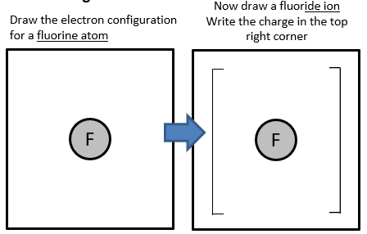
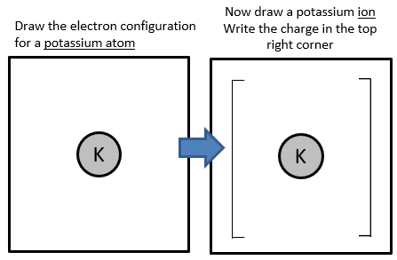

We will understand why ions are formed and how they get their charge
Complete the following exit ticket to show your understanding
Notes:
Please include tasks/questions here rather than just referring to a worksheet. This will save on photocopying and facilitate sharing with other schools.
Try and build tasks/questions which escalate through Bloom’s Taxonomy. This will help with differentiation.

Slide 25
We will understand why ions are formed and how they get their charge
TRACK WITH ME
READ WITH ME
Define the terms ion, cation, and anion
Explain how and why ions form, in terms of electron configurations

